Slide 1
HUMAN POSE ESTIMATION
Presented by
Aleena Poulose
Roll.no.11
Guide
Miss.senu abi
Scrum master
Miss.joice t

Slide 2
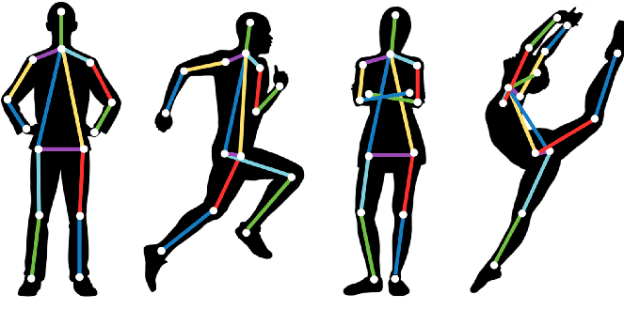

Slide 3
RELEVENCE OF THE TOPIC
Detection of people has long been a primary center for various applications in traditional object detection.
With recent developments in machine-learning algorithms, computers can now understand human body language by performing pose detection and pose tracking.
Human Pose estimation is an important problem that has enjoyed the attention of the Computer Vision community.
It is a crucial step towards understanding people in images and videos.
This step is a crucial prerequisite to multiple tasks of computer vision which include human activity and movement estimation, robotics, human tracking, human-computer interaction, gaming, sign languages, and video surveillance.

Slide 4
DESCRIPTION OF THE PROJECT
Human Pose Estimation identifies and classifies the poses of human body parts and joints in images or videos in 2D
Essentially it is a way to capture a set of coordinates by defining the human body joints like wrist, shoulder, knees, eyes, ears, ankles, and arms, which is a key point in images and videos that can describe a pose of a person.
Then, when an image is given to the pose estimator model as input, it identifies the coordinates of these detected body parts and joints as output and a confidence score showing precision of the estimations.

Slide 5
OBJECTIVE
Human pose estimation aims at predicting the poses of human body parts and joints in
Image
Webcam demo
To estimate the sitting position of a person when side view of the person is given as input.

Slide 6
EXISTING SYSTEM
Classical approaches
The classical approach to articulated pose estimation is using the pictorial structures framework.
The basic idea here is to represent an object by a collection of "parts" arranged in a deformable configuration (not rigid).
A "part" is an appearance template which is matched in an image. Springs show the spatial connections between parts.

Slide 7
PROPSED SYSTEM
Deep learning-based approaches are well defined by their ability to generalize any function (if a sufficient number of nodes are present in the given hidden layer).
When it comes to computer vision tasks, deep convolutional neural networks surpass all other algorithms,.
It has the ability to extract patterns and representations from the given input image with more precision and accuracy than any other algorithm; this makes very useful for tasks such as classification, detection, and segmentation
It can learn complex features when provided with enough training-validation-testing data.

Slide 8
Input & output modules
INPUT
Image
OUTPUT
Image + skeleton based graph

Slide 9
DESCRIPTION OF METHDOLOGY
The main process of human pose estimation is boiled into two basic steps:
localizing human body joints/keypoints
grouping those joints into valid human pose configuration

Slide 10
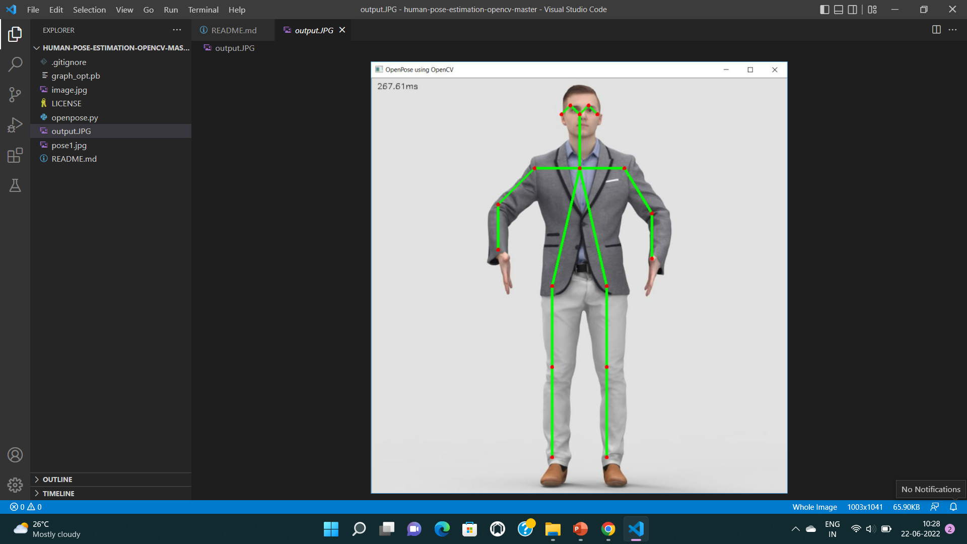

Slide 11
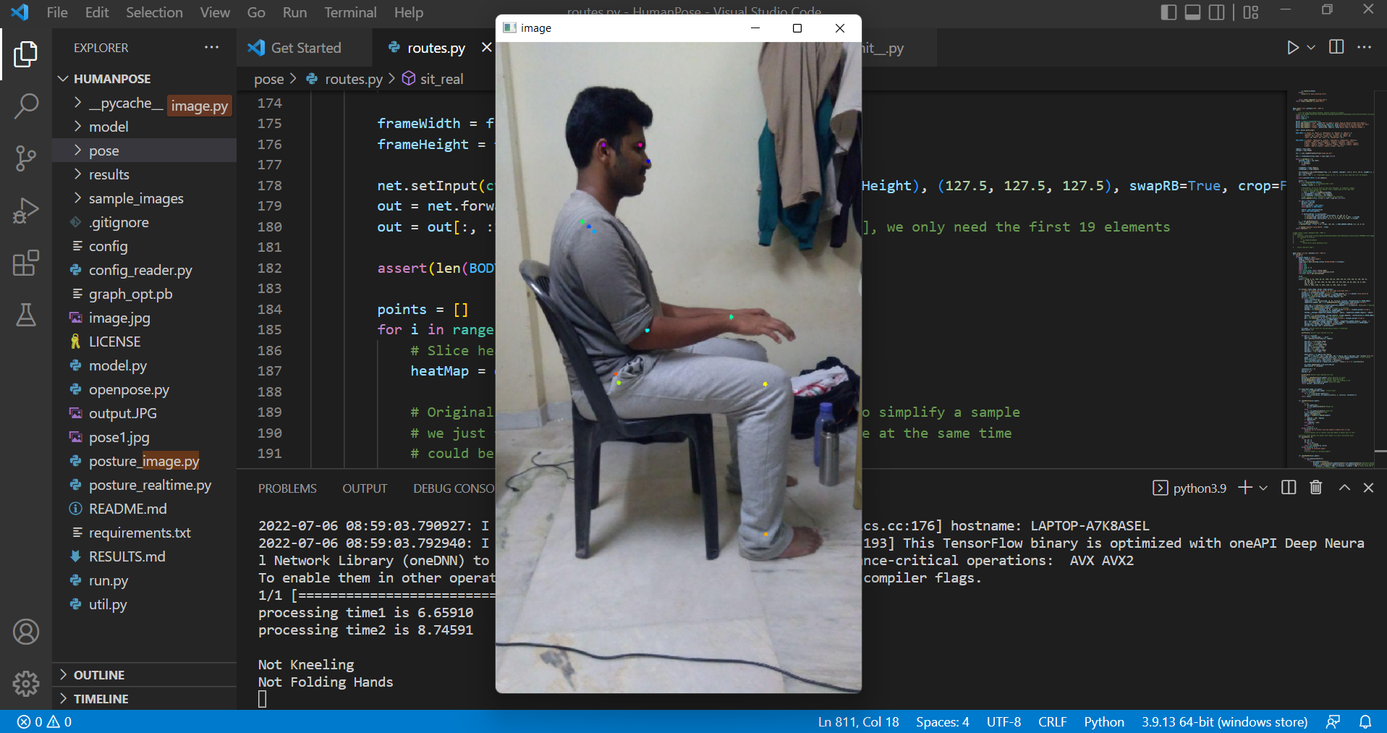

Slide 12
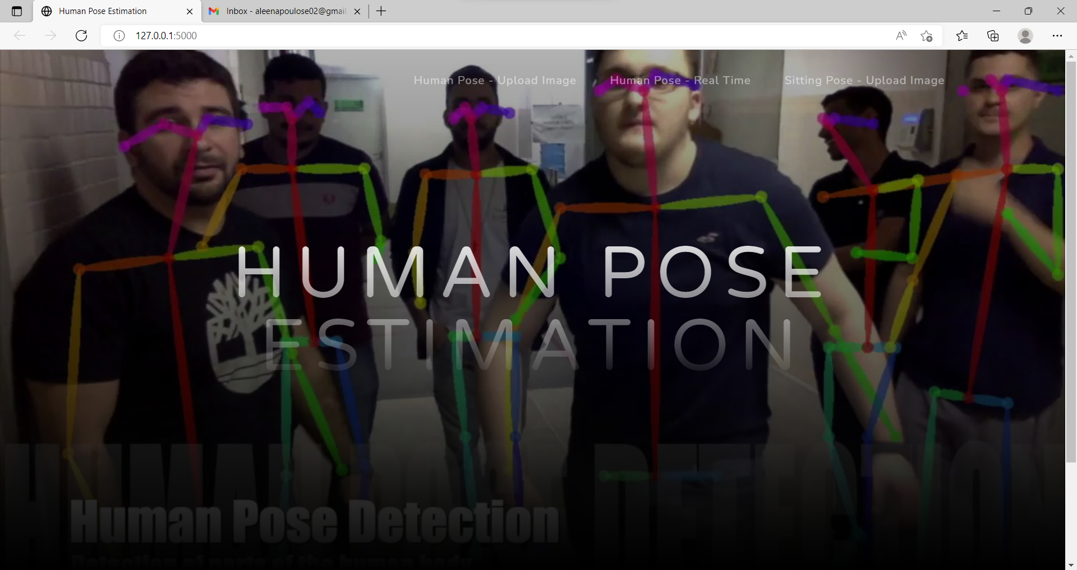

Slide 13


